Slide 1
SPLAY TREES

Slide 2
Splay Trees
Splay trees are Self adjusting Binary Trees with additional property that recently accessed elements as kept near the top and hence, are quick to access next time.
After performing operations, the tree gets adjusted/ modified and this modification of tree is called Splaying.

Slide 3
Why Splaying?
Whenever a node is accessed, a splaying operation is performed on that node. This is a sequence of operations done on the node which sequentially brings up that node closer to root and eventually makes it as root of that tree. Now, if we want to access that same node from the tree then the time complexity will be O(1). This is what we mean by frequently accessed elements are easily accessible in less time.

Slide 4
Splay Trees
Splay trees are tree structures that:
Are not perfectly balanced all the time
Data most recently accessed is near the root. (principle of locality; 80-20 “rule”)
The procedure:
After node X is accessed, perform “splaying” operations to bring X to the root of the tree.
Do this in a way that leaves the tree more balanced as a whole

Slide 5
Splay Tree Terminology
Let X be a non-root node with ≥ 2 ancestors.
P is its parent node.
G is its grandparent node.
G
G
G
G
P
P
P
P
X
X
X
X

Slide 6
Zig-Zig and Zig-Zag
Parent and grandparent in same direction.
Parent and grandparent in different directions.
Zig-zig
4
G
G
5
P
5
Zig-zag
1
P
X
2
X

Slide 7
Splay Tree Operations
1. Helpful if nodes contain a parent pointer.
parent
element
left
right
2. When X is accessed, apply one of six rotation routines.
Single Rotations (X has a P (the root) but no G)
Zig, Zag
Double Rotations (X has both a P and a G)
ZigZig, ZagZag, ZigZag, ZagZig

Slide 8
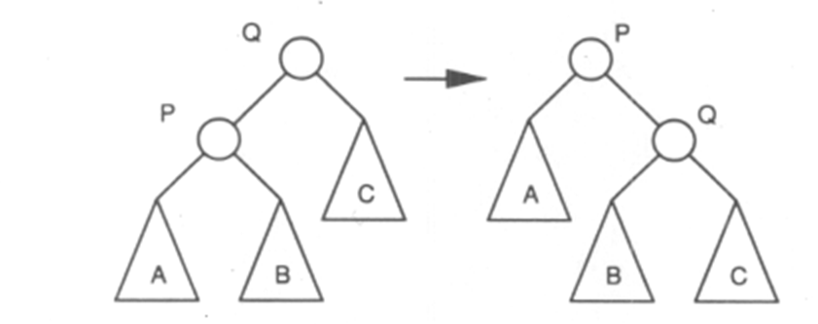
Zig - Splay Tree Operations

Slide 9
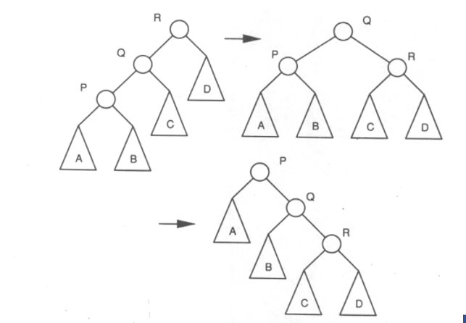
Zig-Zig Splay Tree Operations

Slide 10
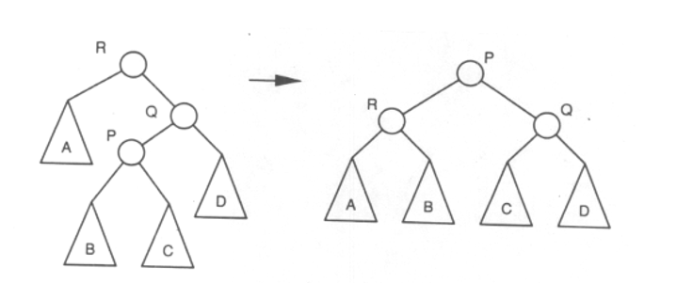
Zig-Zag Splay Tree Operations

Slide 11
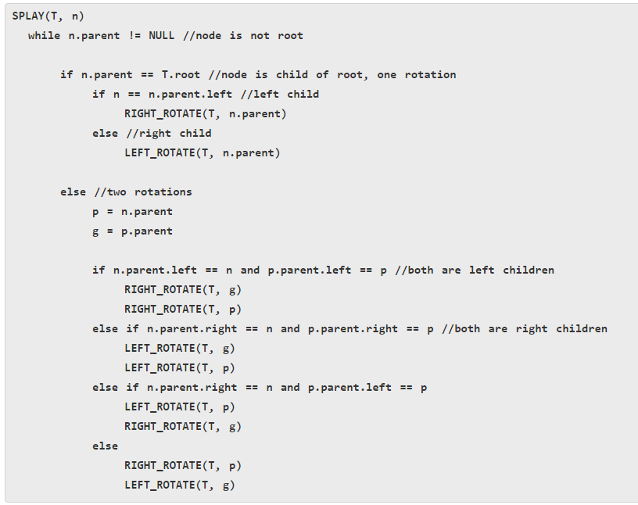
Splay Pseudo code

Slide 12
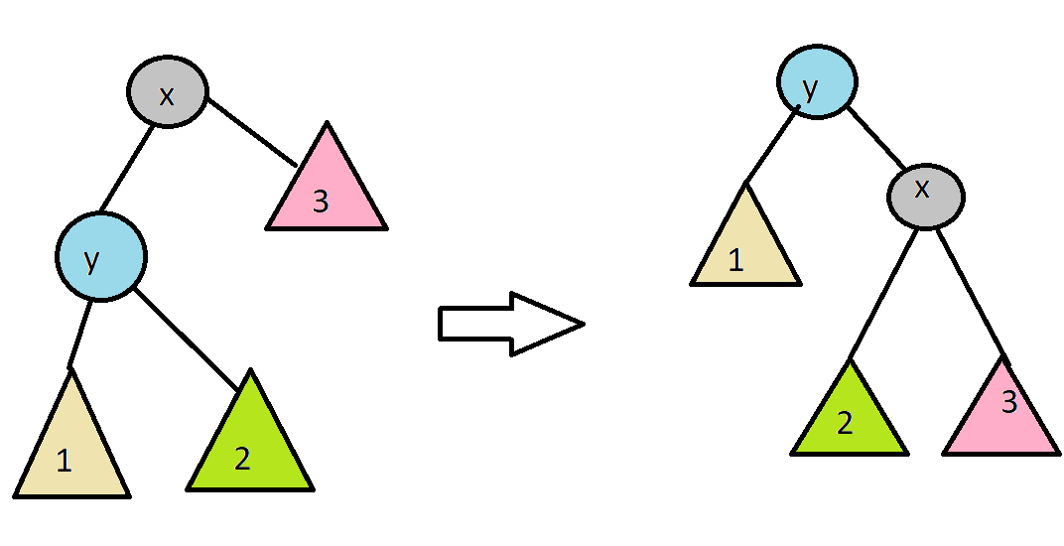
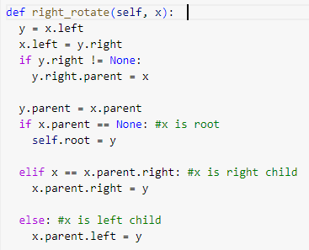
Right (Zig) rotation

Slide 13
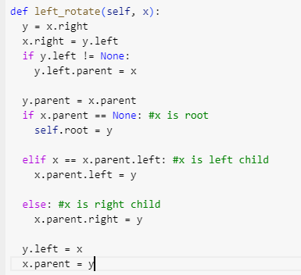
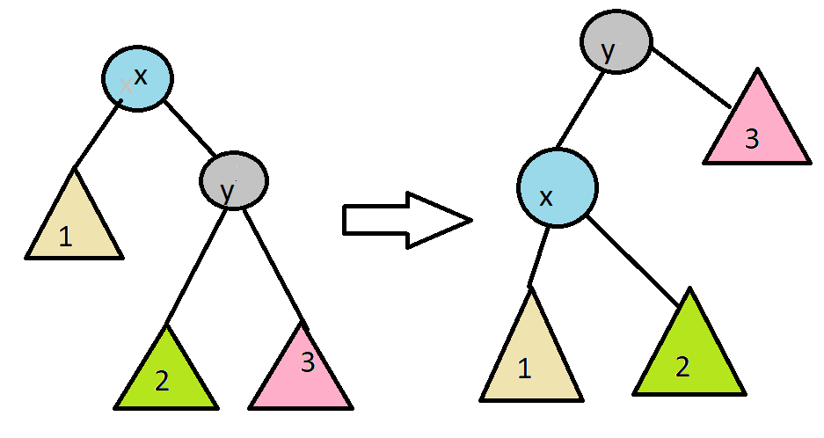
Left (Zag) Rotation

Slide 14
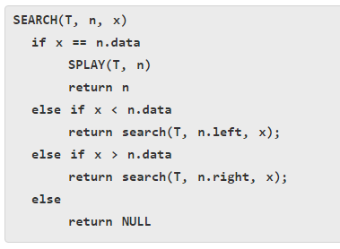
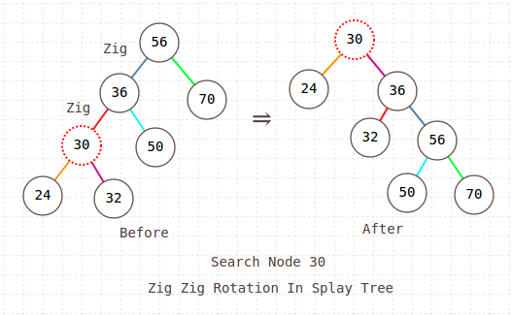
Search in Splay Trees

Slide 15
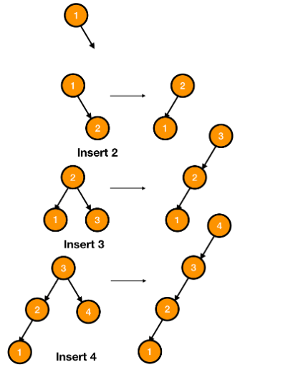
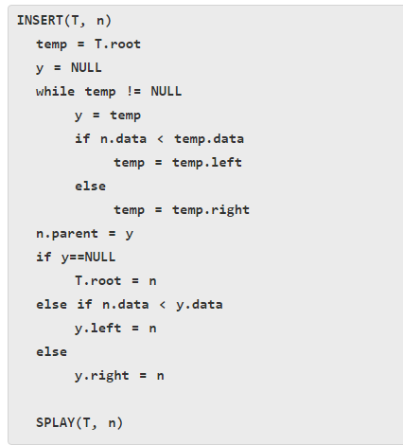
Insert in Splay Tree
Insert x
Insert x as normal then splay x to root.

Slide 16
Delete in Splay Tree
Delete x
Splay x to root and remove it. (note: the node does not have to be a leaf or single child node like in BST delete.) Two trees remain, right subtree and left subtree.
Splay the max in the left subtree to the root
Attach the right subtree to the new root of the left subtree.

Slide 17
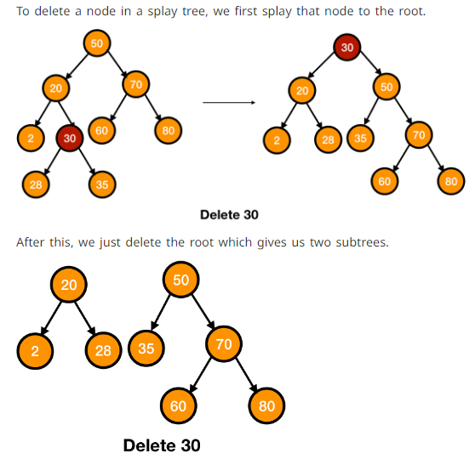
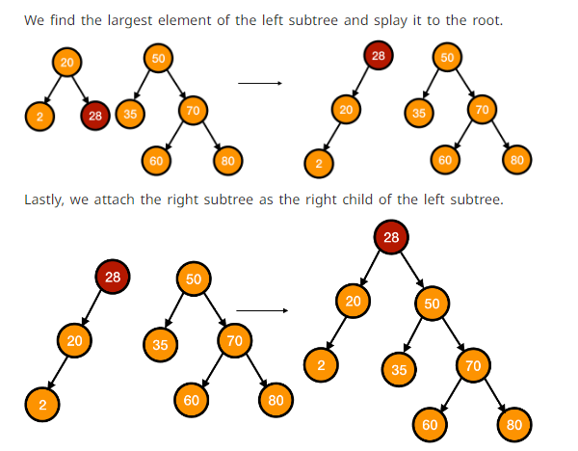
Delete in Splay Trees

Slide 18
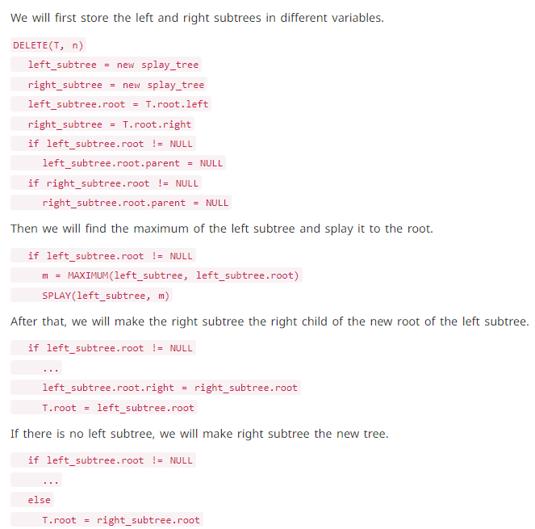
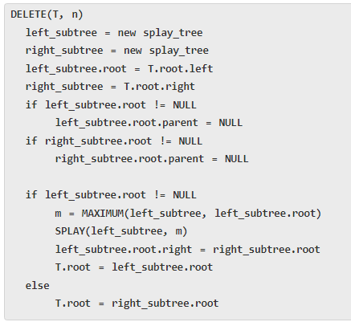
Delete in Splay Trees

Slide 19
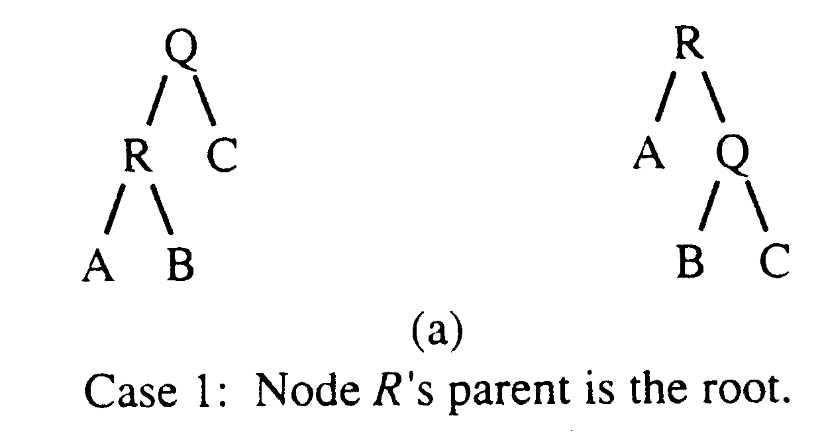
Zig at depth 1 (root)
“Zig” is just a single rotation, as in an AVL tree
Let R be the node that was accessed (e.g. using Find)
Zig moves R to the top →faster access next time
root
Zig

Slide 20
Zig at depth 1
Suppose Q is now accessed using Find
Zag moves Q back to the top
root
Zag

Slide 21
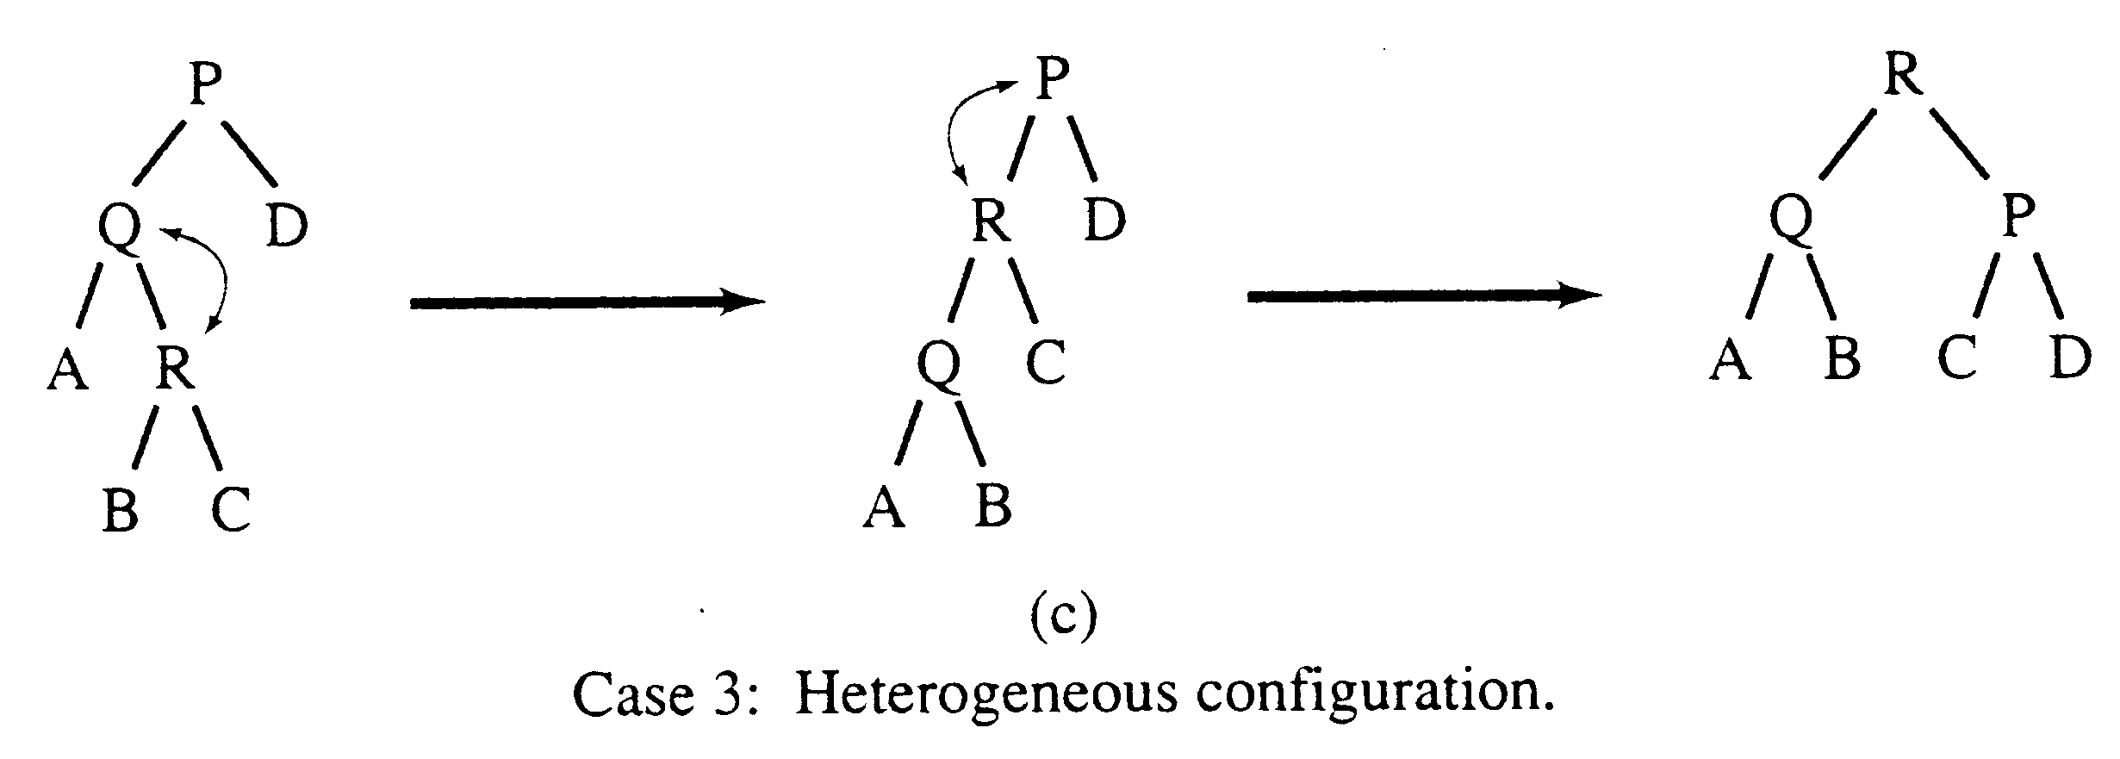
Zag-Zig operation
“Zig-Zag” consists of two rotations of the opposite direction (assume R is the node that was accessed)
(Zag)
(Zig)
ZiaZig

Slide 22
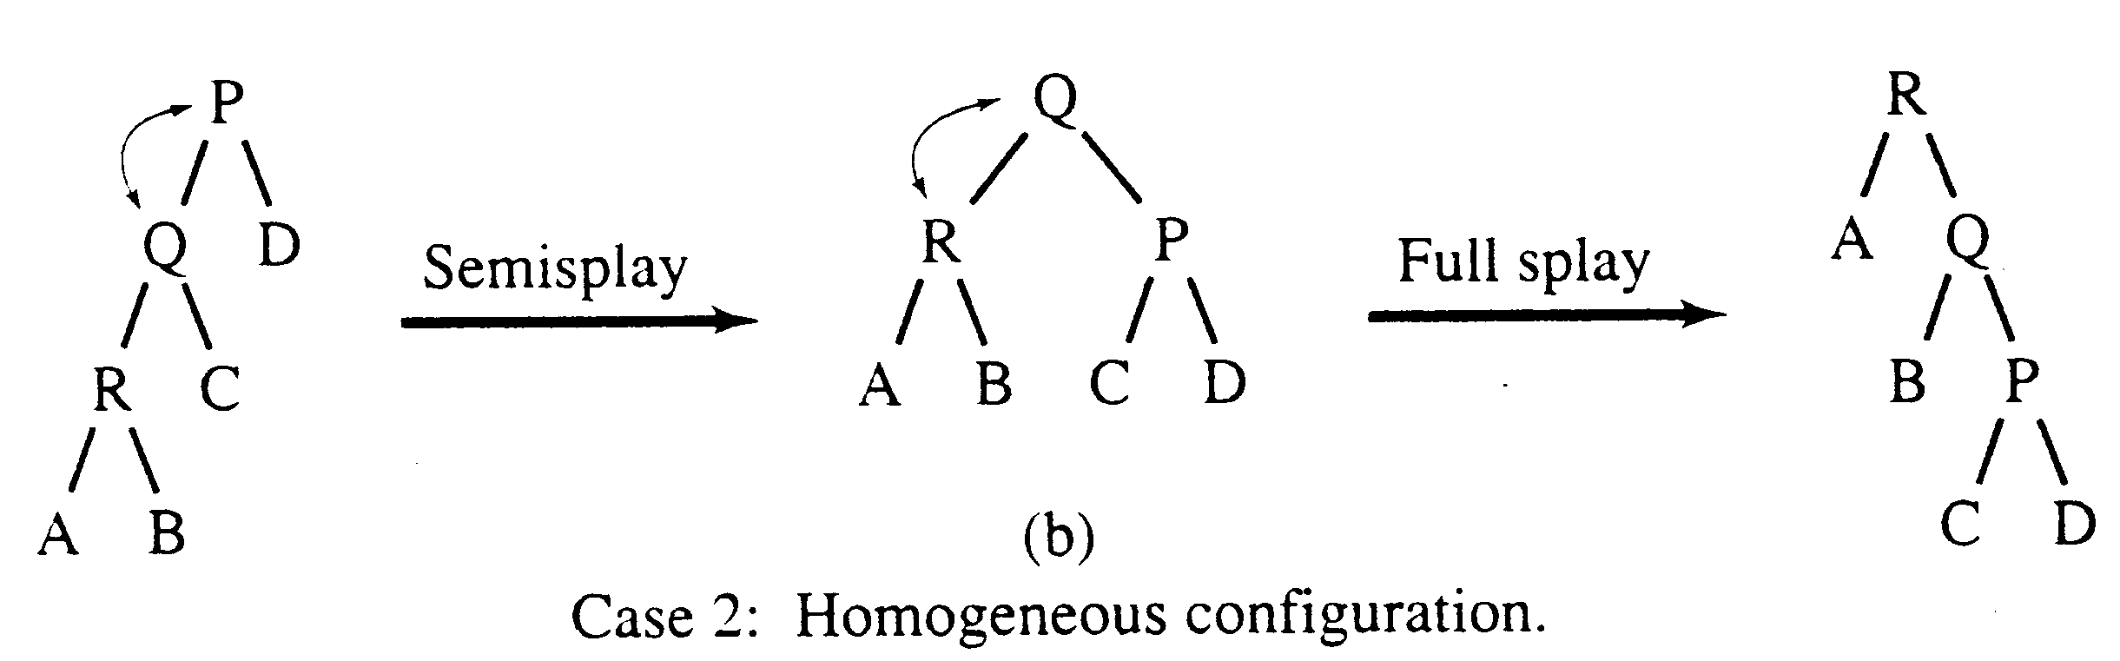
Zig-Zig operation
“Zig-Zig” consists of two single rotations of the same direction (R is the node that was accessed)
(ZigFromLeft)
(ZigFromLeft)
ZigZigFromLeft

Slide 23
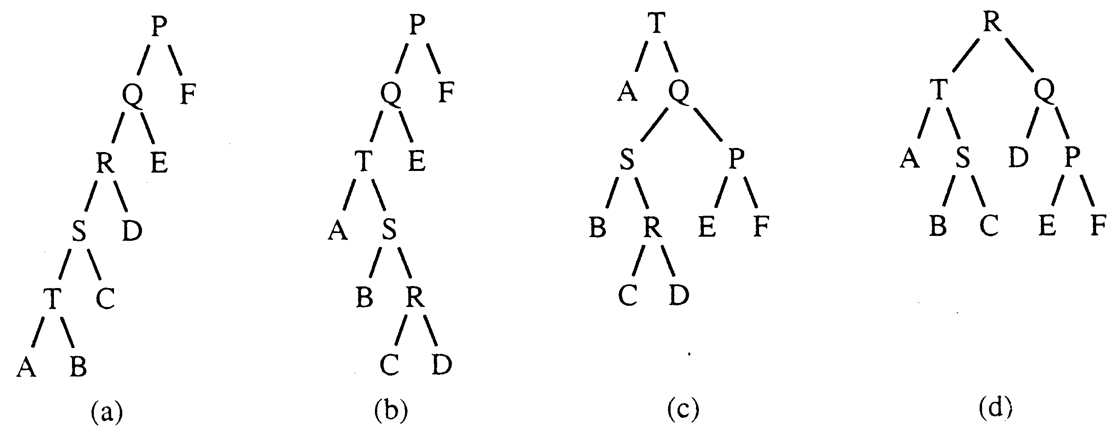
Decreasing depth - "autobalance"
Find(T)
Find(R)

Slide 24
Example Insert
Inserting in order 1,2,3,…,8
Without self-adjustment
1
2
O(n²) time for n Insert
3
4
5
6
7
8

Slide 25
With Self-Adjustment
1
2
3
1
Zag
1
2
2
1
3
2
Zag
2
1
3
1

Slide 26
With Self-Adjustment
4
3
4
2
4
Zag
3
1
2
1
Each Insert takes O(1) time therefore O(n) time for n Insert!!

Slide 27
Analysis of Splay Trees
Splay trees tend to be balanced
M operations takes time O(M log N) for M > N operations on N items. (proof is difficult)
Amortized O(log n) time.
Splay trees have good “locality” properties
Recently accessed items are near the root of the tree.
Items near an accessed one are pulled toward the root.

Slide 28
Drawbacks of splay tree data structure:
Unbalanced Trees: Splay trees can become unbalanced and inefficient if the tree is repeatedly rotated in the same direction.
Memory Usage: Splay trees can use a lot of memory compared to other data structures because each node contains additional information.
Complexity: Splay trees can have a high time complexity for basic operations such as insertion and deletion because the trees need to be reorganized after every operation.
Reorganization Overhead: The splaying operation required in every operation can be time-consuming and result in a high overhead.
Limited Use Cases: Splay trees are not suitable for all data structures and have limited use cases because they don’t handle duplicate keys efficiently.

Slide 29
Applications of the splay tree:
Caching
Database Indexing.
File Systems: Splay trees can be used to store file system metadata, such as the allocation table, directory structure, and file attributes.
Data Compression: Splay trees can be used to compress data by identifying and encoding repeating patterns.
Text Processing: Splay trees can be used in text processing applications, such as spell-checkers, where words are stored in a splay tree for quick searching and retrieval.
Graph Algorithms: Splay trees can be used to implement graph algorithms, such as finding the shortest path in a weighted graph.
Online Gaming: Splay trees can be used in online gaming to store and manage high scores, leaderboards, and player statistics.

Slide 30
References
Splay Trees : Splaying, Insertion and Deletion (codesdope.com)
Introduction to Splay tree data structure – GeeksforGeeks

